Slide 1
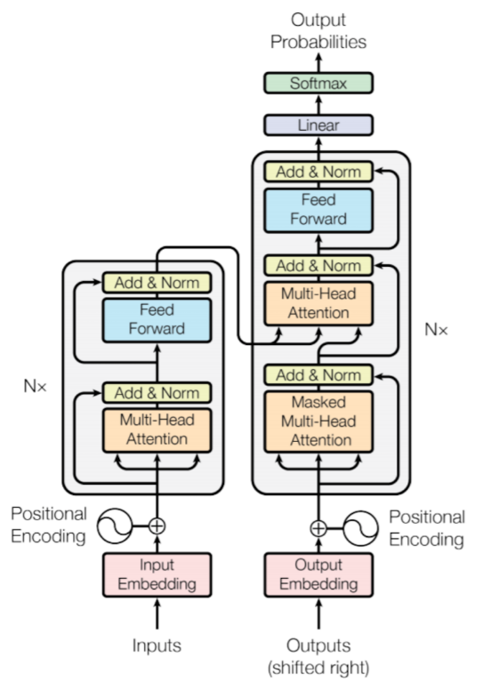
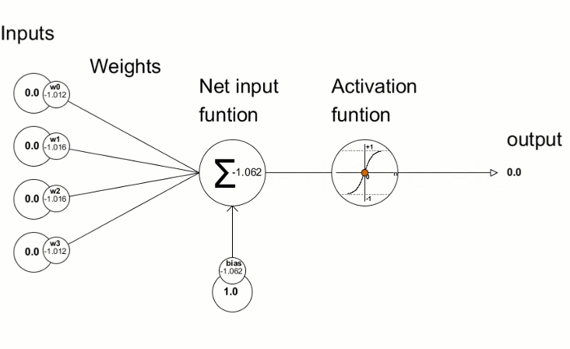
CN7050 Intelligent Systems
Neural Networks & Transformers for Agents Training
Key Topics:
  Neural Networks, Training & Variants
  Origin of Transformers, Architectural and what's the need?
  Encoder & Decoder explanation
  Unfold the Encoder & Decoder
  Future potential in AI Agents.
Goal: To provide a foundational understanding of Transformers
Dr Azhar Mahmood
Office: EB.1.85 Email: a.mahmood3@uel.ac.uk

Slide 2
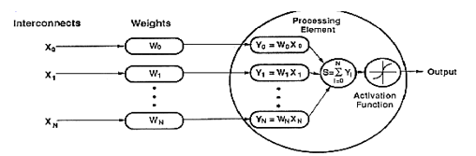
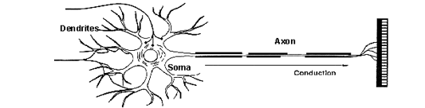
Neural Networks Viewpoints
Technical viewpoint: Some problems such as character recognition or the prediction of future states of a system require massively parallel and adaptive processing.
Biological viewpoint: ANNs can be used to replicate and simulate components of the human (or animal) brain, thereby giving us insight into natural information processing.

Slide 3
When to Consider NN?
Input is high-dimensional discrete or real-valued (e.g. raw sensor input)
Complex pattern recognition
Non-linear data
Automation of complex tasks
Lack of a clear process
Possibly noisy data
Form of target function is unknown
Human readability of result is unimportant

Slide 4
General Structure of NN
Training ANN means learning the weights of the neurons
Weights and biases are important because they help the neural network learn the relationship between the input data and the desired output. By adjusting these parameters during training, the network can make accurate predictions and optimize its performance.
Notes:
Weights and biases are important because they help the neural network learn the relationship between the input data and the desired output. By adjusting these parameters during training, the network can make accurate predictions and optimize its performance.

Slide 5
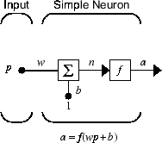
Working of a Single Neuron
Three distinct functional operations
1. weight function, the input p is multiplied by the weight w to form the product wp.
2. net input function, the weighted input wp is added to the bias b to form the net input n.
3. Transfer/activation function, the net input is passed through the transfer function f, which produces the output a.
Read: https://uk.mathworks.com/help/deeplearning/ug/neuron-model.html
Neuron Firing Rule:
IF (Input1 x weight1) + (Input2 x weight2) + (Bias) satisfies Threshold value
Then Output = 1
Else Output = 0

Slide 6
Learning by Trial‐and‐Error
  Trial:
  Processing an input to produce an output (In terms of simple ANN: Compute the output function of a given input)
  Evaluate:
  Evaluating this output by comparing the actual output with the expected output.
  Adjust:
  Adjust the weights.

Slide 7

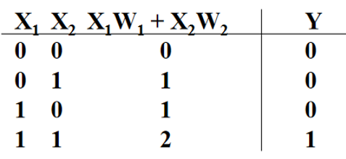
Learning Algorithm
Set initial values of the weights randomly.
Input: truth table of the AND
Do
  Read input (e.g. 0, and 0)
  Compute an output (e.g. 0.60543)
  Compare it to the expected output. (Diff= 0.60543)
Modify the weights to minimize error. All possible weights based on learning
Loop until a condition is met
Condition: certain number of iterations
Condition: error threshold

Slide 8
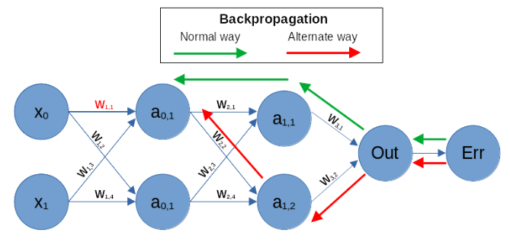
Backpropagation
Check out the following examples for step-by-step Backpropagation
https://mattmazur.com/2015/03/17/a-step-by-step-backpropagation-example

Slide 9
Backpropagation
  Iteratively process a set of training tuples & compare the network's prediction with the actual known target value.
  For each training tuple, the weights are modified to minimize the mean squared error between the network's prediction and the actual target value
  Modifications are made in the “backwards” direction: from the output layer, through each hidden layer down to the first hidden layer, hence “backpropagation”
  Steps
    Initialize weights (to small random) and biases in the network
    Propagate the inputs forward (by applying activation function)
    Backpropagate the error (by updating weights and biases)
    Terminating condition (when error is very small, etc.)
9
Notes:
9

Slide 10
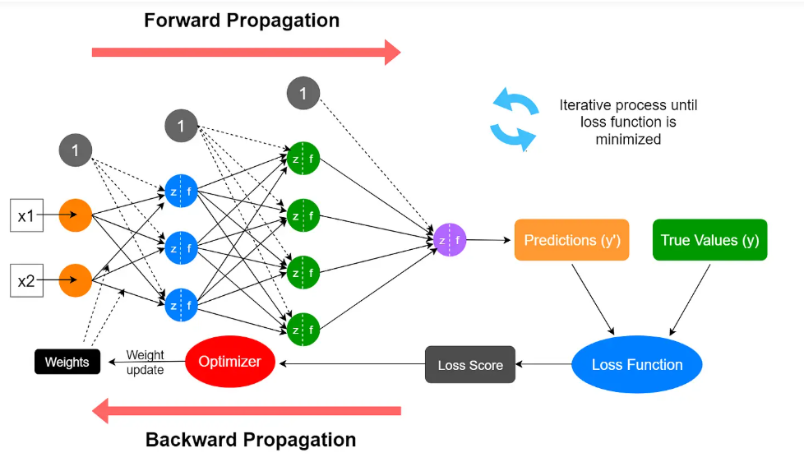
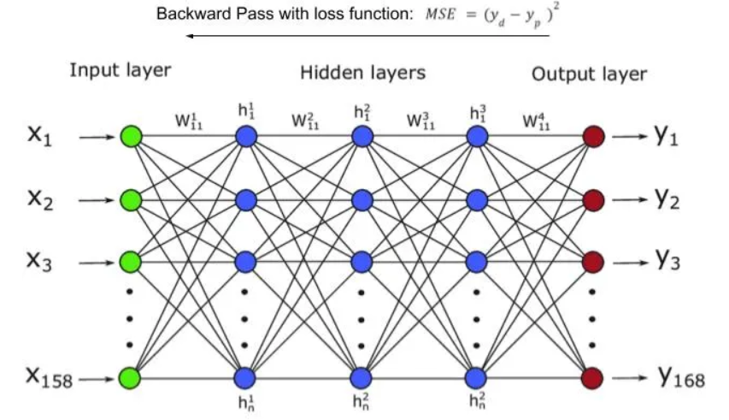
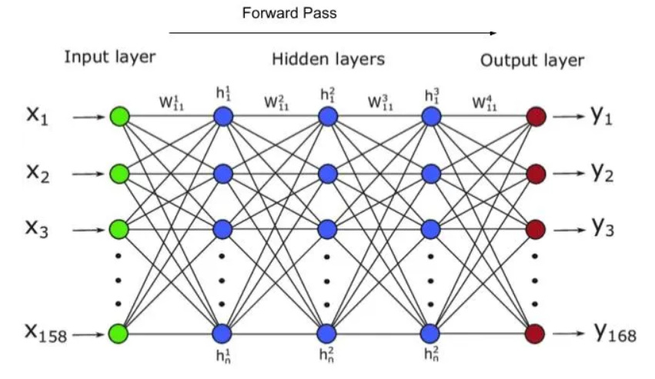
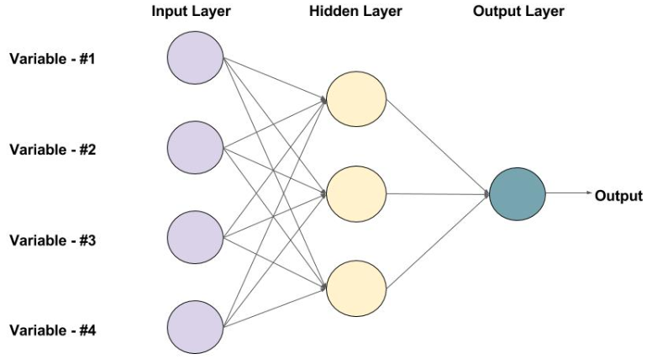
Feedforward Neural Networks (FNN)
  Develop Agent for:
    Classification, Forecasting, Image and speech recognition, Fraud detection, Credit scoring, Computer vision

Slide 11
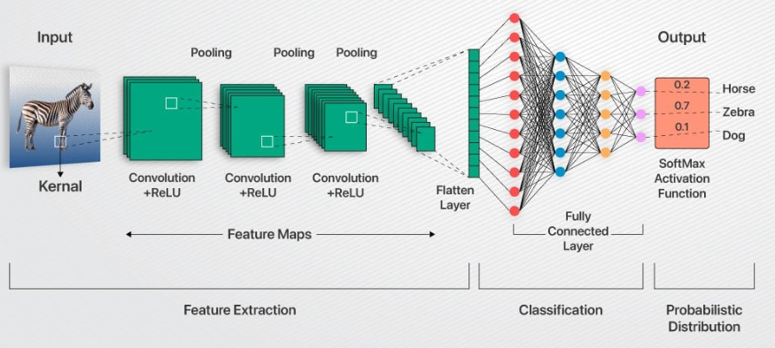
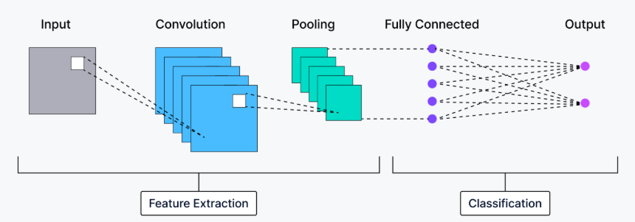
Convolutional Neural Networks (CNN)
  Develop Agent for:
    Autonomous vehicles, Facial recognition systems, Medical imaging analysis, Retail and e-commerce agents, Industrial automation

Slide 12
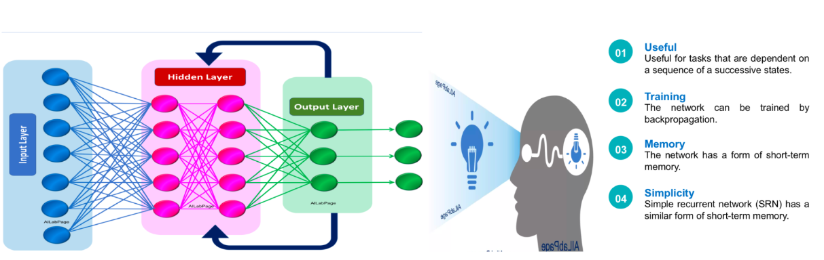
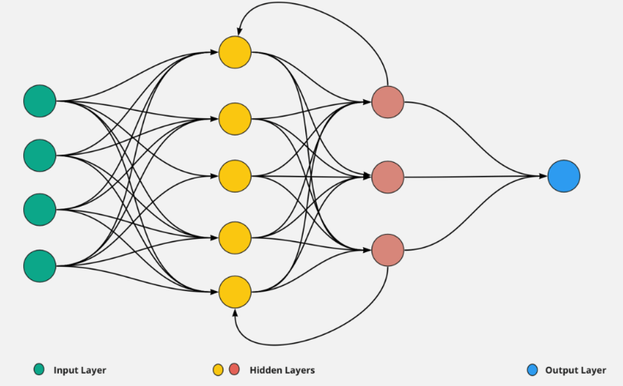
Recurrent Neural Networks (RNN)
RNNs have a feedback loop that allows the output from one step to be used as an input for the next, making them effective for tasks like natural language processing, speech recognition, and time-series analysis.
  Develop Agent for:
    Natural Language Processing (NLP), Speech recognition agents, Time-series forecasting agents, Image and video analysis agents, Gesture recognition agents

Slide 13
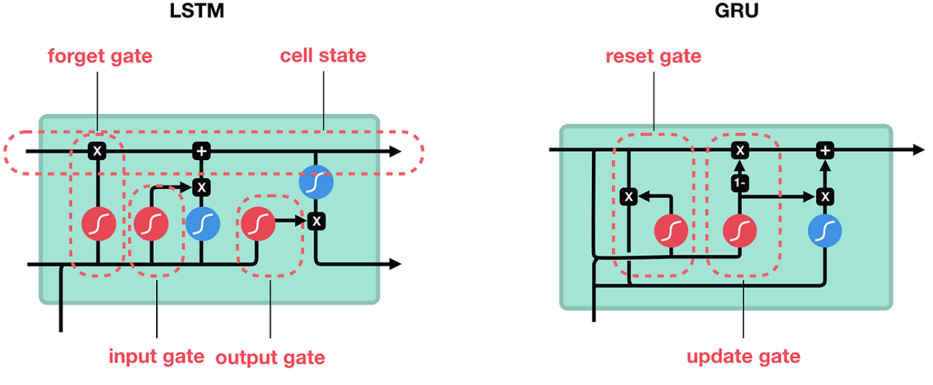
Long Short-Term Memory (LSTM) and Gated Recurrent Unit (GRU)
Enhanced versions of RNNs designed to solve the "vanishing gradient" problem, allowing them to learn long-term dependencies in sequential data more effectively.
Any sequential task that requires remembering information over long periods. Can handle long-term dependencies more effectively.
Notes:
The forget gate decides which information to throw away from the cell state.
The input gate decides which new information to store in the cell state.
The output gate decides what part of the cell state to output.

Slide 14
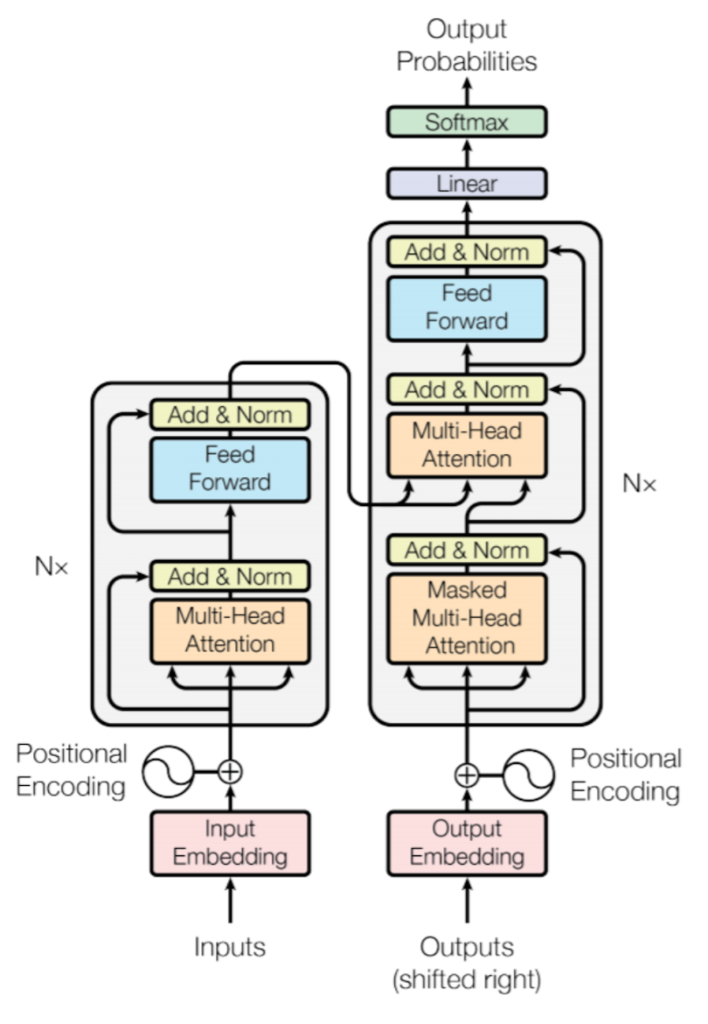
Transformer Networks
Conversational AI: Agents like ChatGPT can engage in natural conversations for customer support, content creation, or as virtual assistants.
Multimodal Agents: These agents can process and generate content across multiple modalities. Examples include creating images from text descriptions (DALL-E) or answering questions about an image.
Generative AI for creative tasks: Agents can write code (GitHub Copilot), compose music, or draft written content.

Slide 15
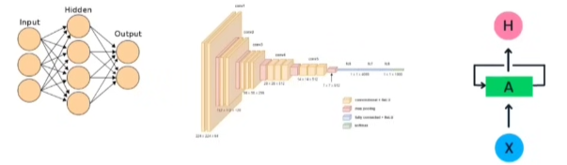
What is a Transformer?
Definition: A neural network architecture designed for sequence-to-sequence tasks, where both input and output involve sequential data.
  Machine Translation.
  Text Summarization.
  Question-Answering Systems.
Key Features:
  Utilizes Self-Attention instead of LSTMs for parallel processing.
  Processes all words in a sentence simultaneously, enabling scalability and handling large datasets efficiently.
  Consists of Encoder and Decoder components.
Advantage: Faster training due to parallel processing, making it suitable for large-scale datasets.
https://arxiv.org/abs/2306.07303
Notes:
Tab –Image- text

Slide 16
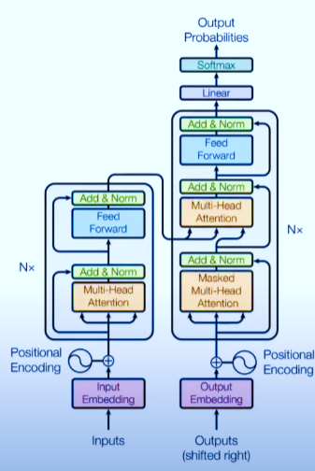
Impact of Transformers on Tech and Society
Transformative Nature:
  Initially designed for Machine Translation.
  Unexpectedly evolved into a keystone of modern AI.
  Google Barin 2017
Technological Impact:
  Revolutionized Deep Learning and AI applications.
  Enabled breakthroughs in tools like ChatGPT and other NLP systems.
Economic and Social Impact:
  Produced numerous startups leveraging Transformer technology.
  Raised billions in funding and created a wave of job opportunities.
  Led in an AI revolution that is reshaping industries.
Attention Is All You Need: https://proceedings.neurips.cc/paper_files/paper/2017/file/3f5ee243547dee91fbd053c1c4a845aa-Paper.pdf

Slide 17
Impact of Transformers on Tech and Society
Revolutionizing Natural Language Processing (NLP)
Rule-based systems, Naive Bayes, Hidden Markov Models.
Advanced methods: Deep learning, LSTMs, RNNs
Enables machines to understand and respond like human
Transformers outperform all previous techniques in NLP tasks.
Tools like ChatGPT, BERT offer advanced solutions to daily queries. Enable Transfer Learning
Hugging Face:Accessing pre-trained models
Transformers: 50 years of progress achieved in 6-7 Years
  AI-based systems replacing traditional support channels
Multimodal Capability of Transformers
Can process images, speech, and other types of multimodal data,
Input text→ Output Image
Unified Representation
Applied cross different data types for similar results
ChatGPT: Search by text, Image, Audio
DALL·E and MidJourney generate images from text, Runway ML and Runway Video create videos from text
Multimodal capability has led to the rise of New Apps and Startups
Notes:
Hugging Face is an American company that provides an open platform and tools for machine learning, with a strong focus on natural language processing (NLP).

Slide 18
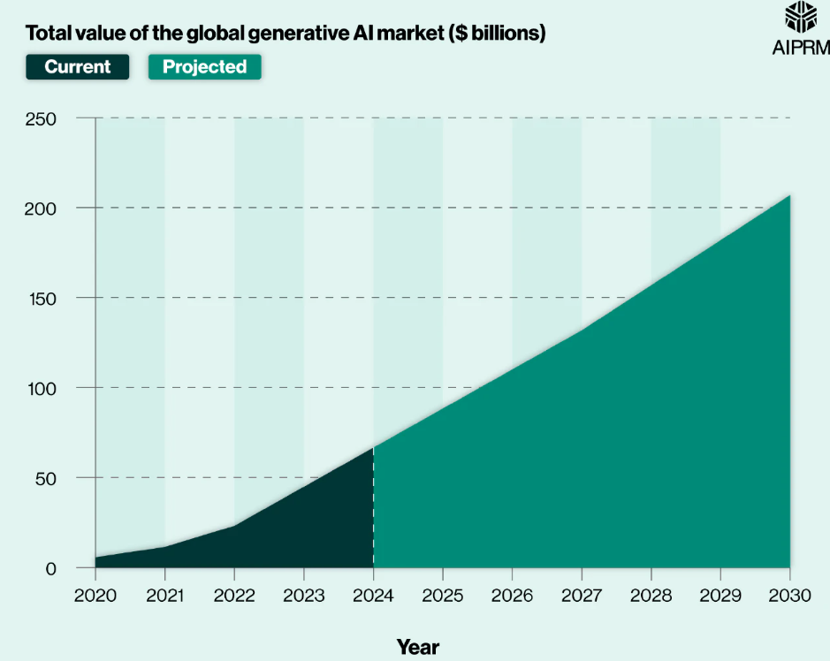
Acceleration of Generative AI (Gen AI)
Generative AI: generate new content such as: Text generation, Image creation, Video production, Generative Adversarial Networks (GANs)
Human-like text generation: chatbots and AI-driven applications, Transformers significantly advanced text generation ChatGPT
Impact on Various Domains:
Text Generation: ChatGPT's ability to generate human-like text
Multimodal AI: MidJourney, DALL·E
Speeding up Innovation: AI tools for image editing (like Adobe), Google phone Image Editing on the go
Generative AI in Industry: Skills in Generative AI for Data Science Positions.

Slide 19
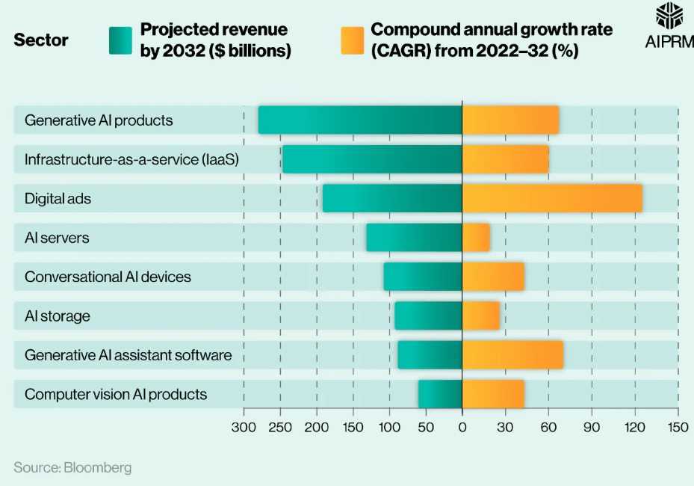
Acceleration of Generative AI (Gen AI)
Unification of Deep Learning with Transformers: Different architectures for different problem types:
  Tabular Data: Decision Trees, SVMs
  Image Data: CNNs
  Sequential Data: RNNs
  Generative Tasks: GANs
Paradigm Shift: Transformers have become a unified architecture for solving multiple deep learning problems:
  NLP: Sequence-to-sequence tasks
  Generative AI: Text, Image, Video generation
  Computer Vision: Image classification and recognition
  Reinforcement Learning: Solving complex RL tasks
  Scientific Research: Transformers in research domains
Benefits: Unified solution for a range of domains, Simplifies model development and deployment
Challenges:
  High computational cost and need for large datasets
  Potential for future models to beat Transformers

Slide 20
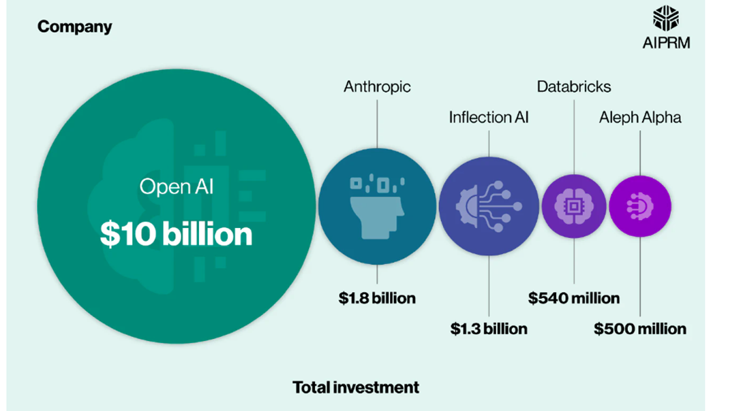
A Breakdown of Gen AI Companies
https://www.aiprm.com/generative-ai-statistics/

Slide 21
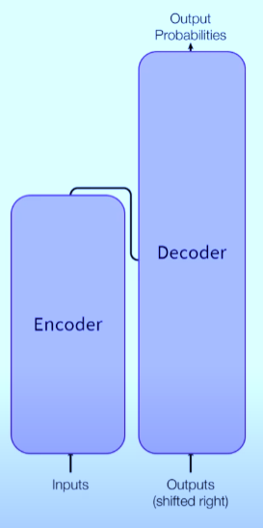
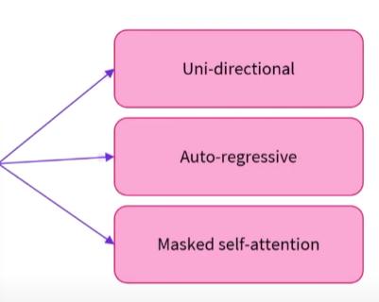
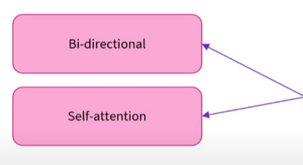
Transformer’s Architecture

Slide 22
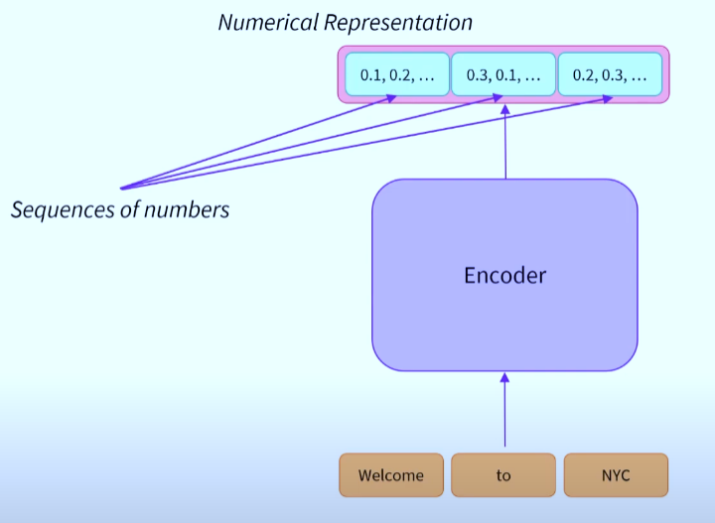
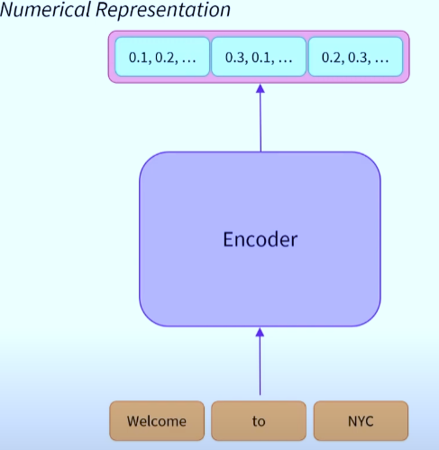
Transformer’s Architecture- Encoder

Slide 23
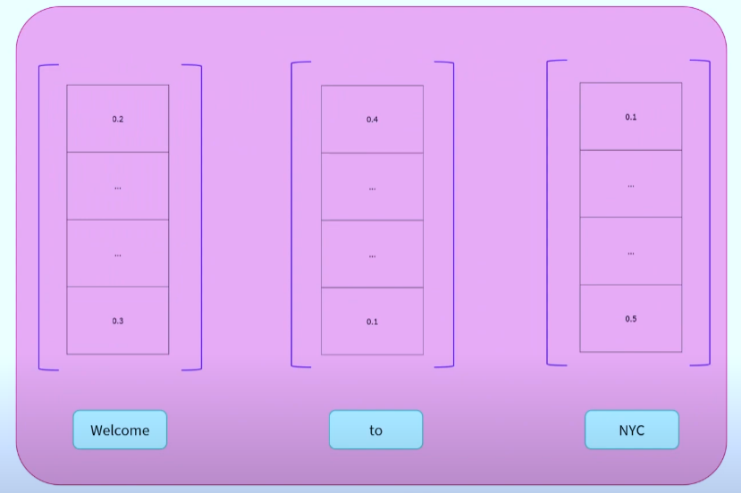
Transformer’s Architecture- Encoder
Vectors
Notes:
BERT 768 Vector

Slide 24
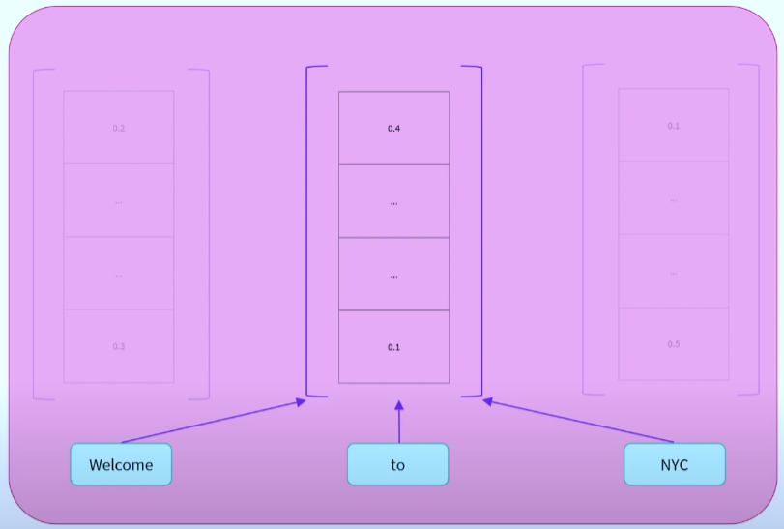
Transformer’s Architecture- Encoder
Context-
Self Attention Mechanism
The self-attention mechanism relates to different positions (or different words) in a single sequence, to compute a representation of that sequence.
This means that the resulting representation of a word has been affected by other words in the sequence.

Slide 25
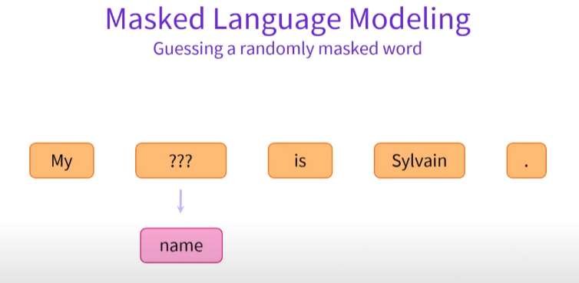
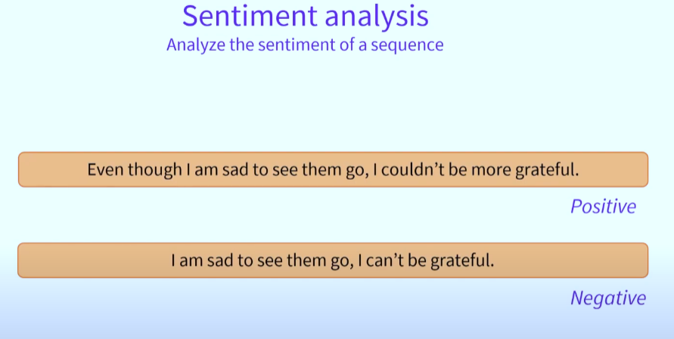
Encoder
Encoders can be used as standalone models in a wide variety of tasks.
  For example, BERT, arguably the most famous transformer model, is a standalone encoder model and at the time of release beat the state of the art in many sequence classification tasks, question answering tasks, and masked language modeling.
  The idea is that encoders are very powerful at extracting vectors that carry meaningful information about a sequence.
  This vector can then be handled down the road by additional layers of neurons to make sense of them. BERT, RoBERTa, ALBERT
Notes:
BERT for MLM
SA: use sequence of words to identify the Sentiments

Slide 26
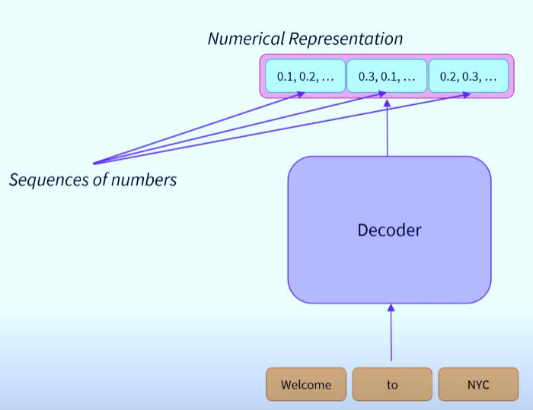
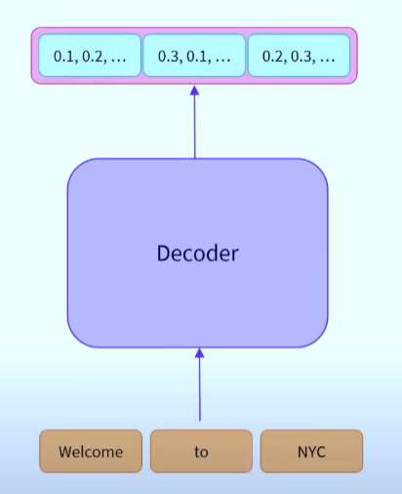
Transformer’s Architecture- Decoder
Notes:
GPT-2, GPT Neo

Slide 27
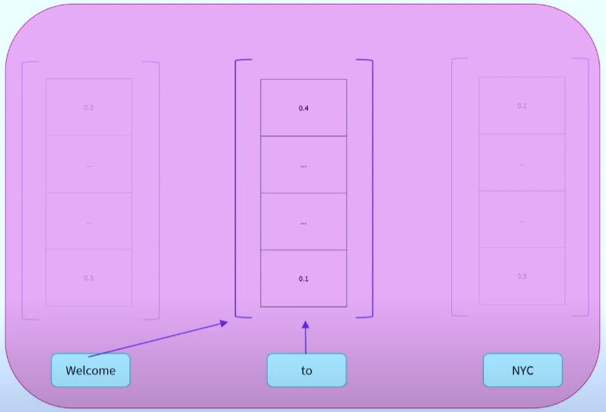
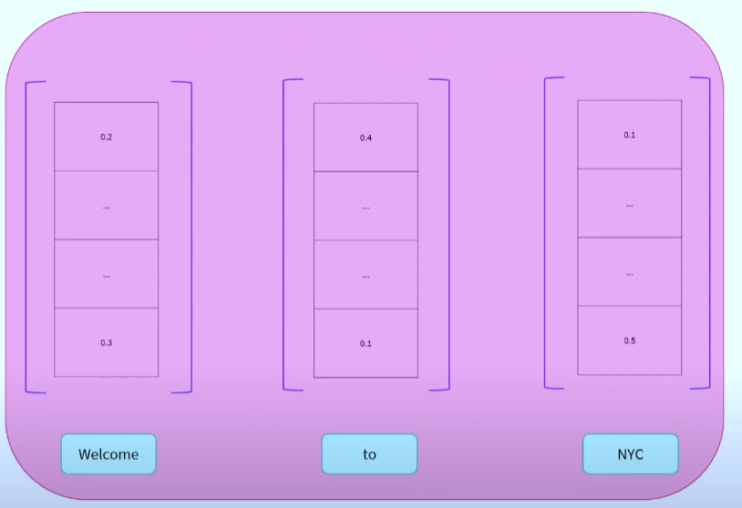
Transformer’s Architecture- Decoder
Single Context
Masked Self Attention Mechanism
Uni Directional

Slide 28
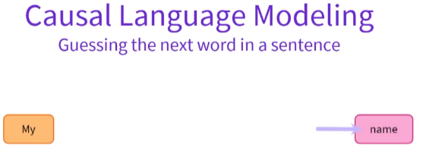



Decoder
Decoder can be used as standalone models. As they generate a numerical representation, they can also be used in a wide variety of tasks.
The decoders, having only access to their left context, are inherently good at text generation: the ability to generate a word, or a sequence of words, given a known sequence of words.
In NLP, this is known as Causal Language Modeling. GPT-2 , GPT Neo
Notes:
GPT Size 1024 of context word
Auto-regressive models re-use their past outputs as inputs in the following steps.

Slide 29

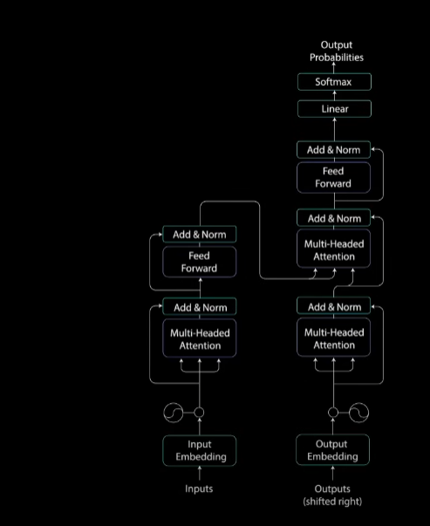
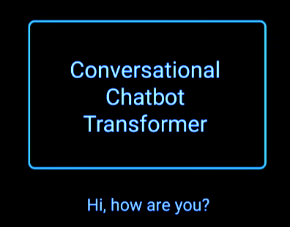
Transformer Arch- Example

Slide 30
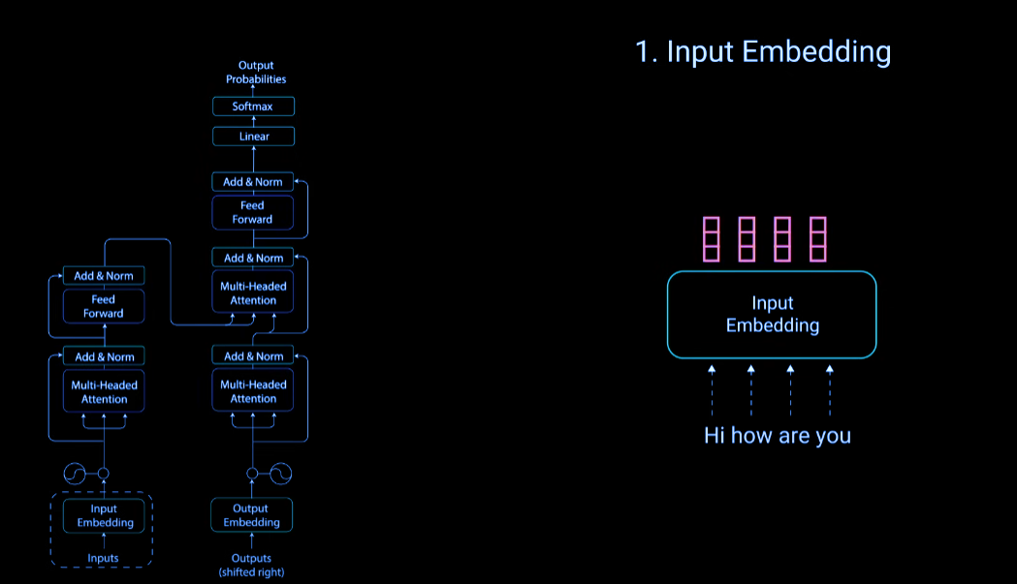
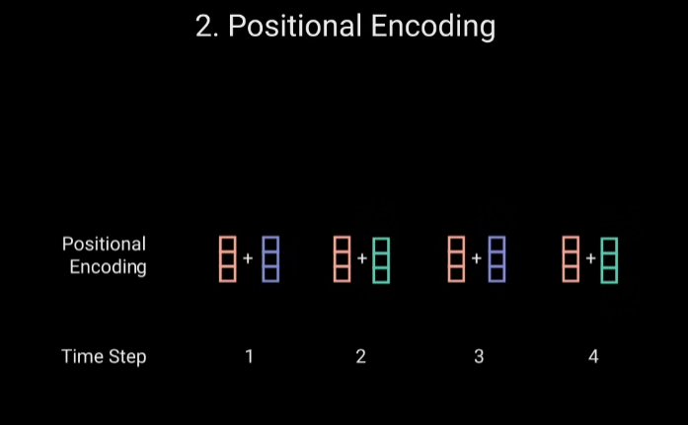

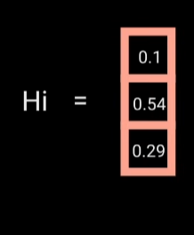
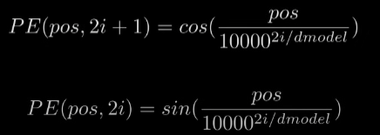
Transformer Arch- Example
Notes:
Cos is for (1,3) all odd and for even use Sin
No of rows =no of unique token in voc * dimens

Slide 31
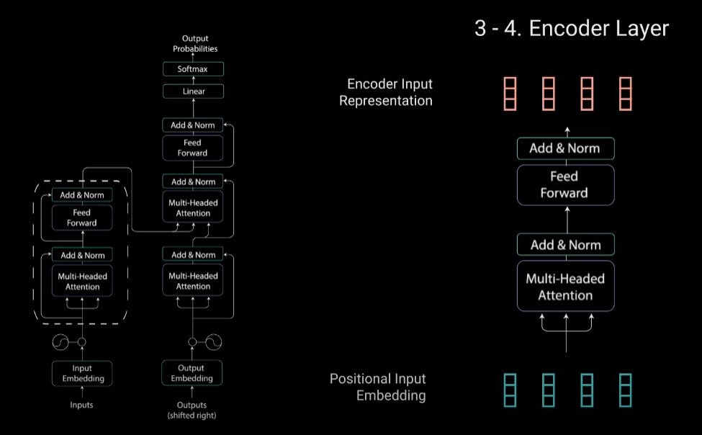
Transformer Arch- Example

Slide 32
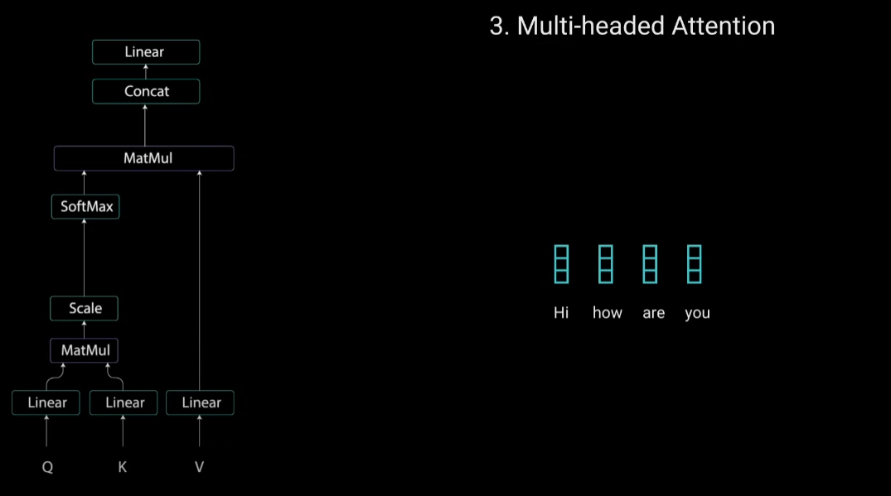
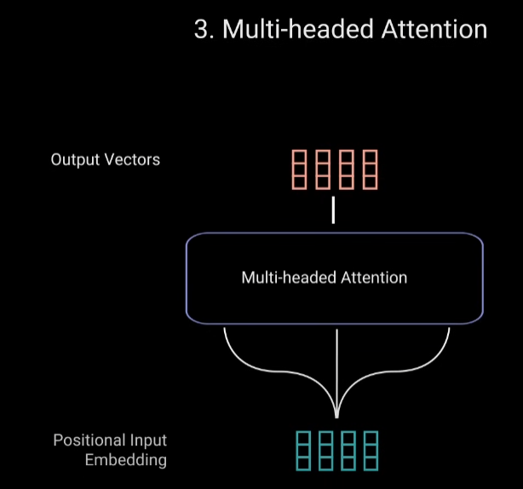
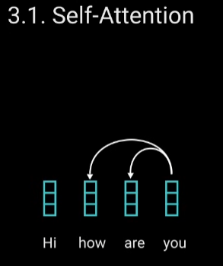
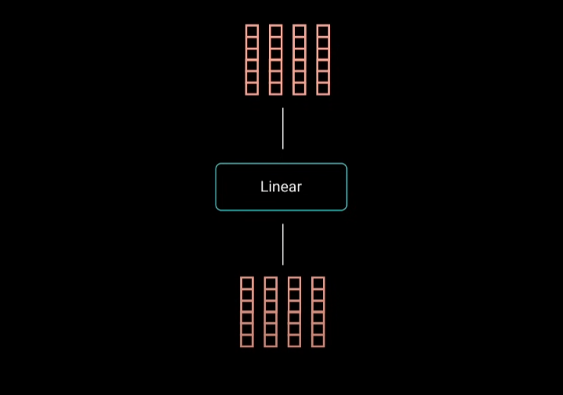
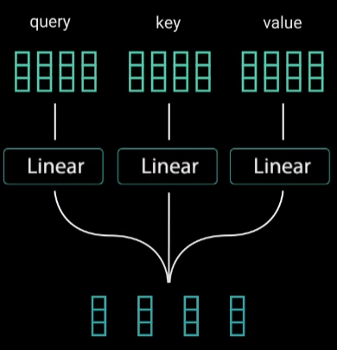
Transformer Arch- Example

Slide 33
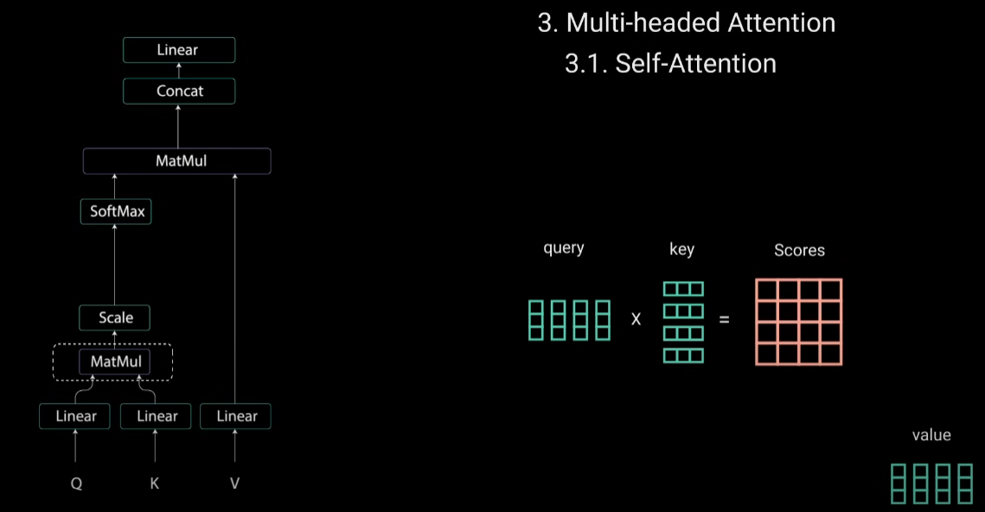
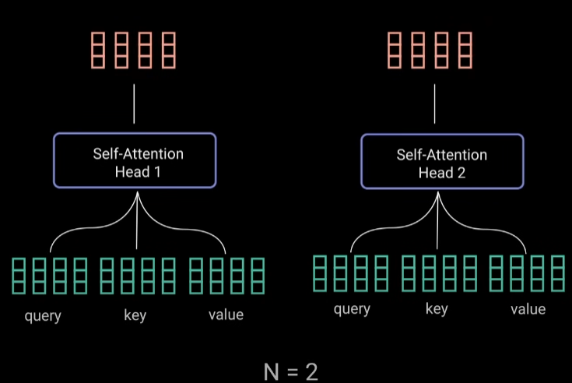





Transformer Arch- Example

Slide 34



Transformer Arch- Example

Slide 35



Transformer Arch- Example

Slide 36





Transformer Arch- Example

Slide 37

Transformer Arch- Example
Notes:
10000= 10000 classes
Then Soft produce probability score between 0 to 1 for each class. The highest word class with their position makes the output.

Slide 38

Timeline of LLMs
A timeline of LLMs, open-source model are highlighted in yellow.

Slide 39

Comparative Analysis

Slide 40


Neural Networks Simulators
The simulator will help you understand how artificial neural network works.
https://www.mladdict.com/neural-network-simulator
https://playground.tensorflow.org
Thanks!!!
Reach out with any questions on MSTeams
Email a.mahmood3@uel.ac.uk

